Slide 1
BASE Research
Evaluating AI agents
for pathogen
genomic surveillance
First meeting
12 October 2026
Bryan Tegomoh, MD, MPH

Slide 2
Introductions and today’s agenda
Conversation | Time
Our backgrounds, skills and learning goals | 15 min
Public health and genomic epidemiology | 15 min
Research question, data and agent evaluation | 15 min
Working agreement and first deliverables | 10 min
Questions and next meeting | 5 min
02

Slide 3
Genomics in public health
Detect and investigate clusters
Sequence similarity gains meaning from exposure and sampling data.
Follow changes over time
Lineage and clade patterns depend on who and what gets sampled.
Connect evidence to a response
Laboratory findings inform an investigation alongside epidemiology.
Armstrong et al., NEJM 2019. Duncan MacCannell, coauthor.
03

Slide 4
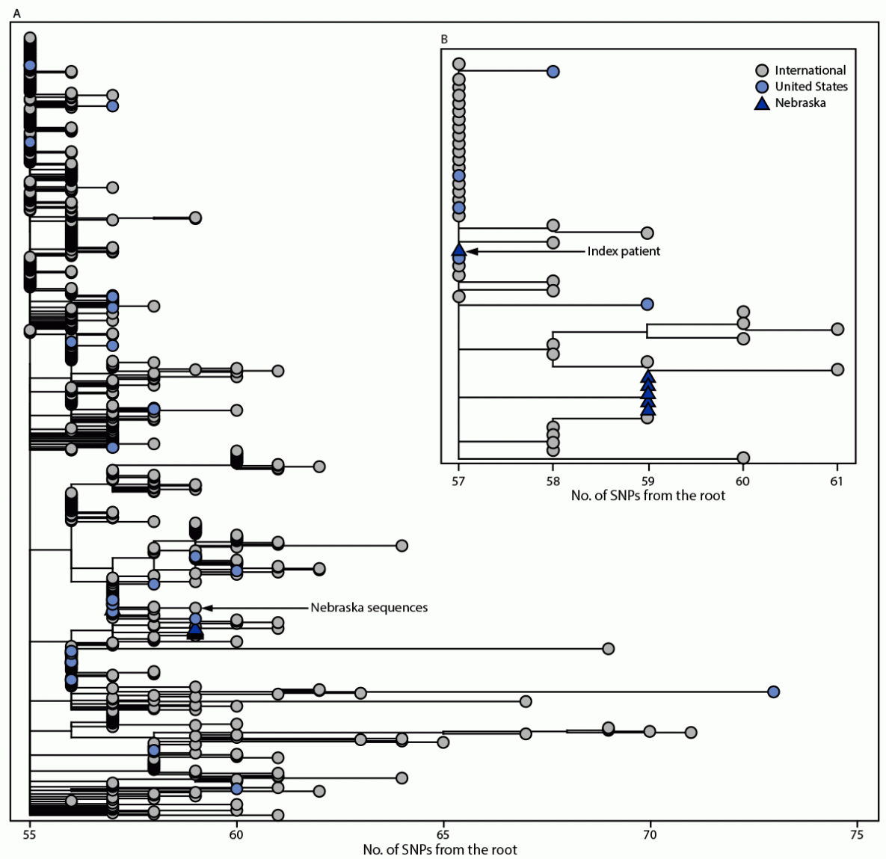
Nebraska’s Omicron household cluster
Six household cases
Genomic relatedness
Exposure and travel history
Timing of illness
What could an agent conclude
from the tree alone?
Jansen, Tegomoh et al., MMWR 2021. Published figure.
04

Slide 5
Clinical, wastewater and environmental sampling
Source | Observation | Interpretation
Clinical | Specimen or isolate linked to a sampled person | Case context and sampling selection
Wastewater | Mixed signal from a catchment and time | Community trends, with mixture uncertainty
Other environmental | Sample from water, air or a surface | Collection setting and background context
Wastewater is environmental surveillance.
Targeted and metagenomic describe sequencing approaches.
05

Slide 6
The research question
How accurately and reproducibly can supervised
AI agents analyze sequencing data to support
pathogen cluster detection and variant surveillance?
How does orchestration affect performance against a defined baseline?
Clinical and environmental data, including wastewater and metagenomics.
One primary setting first, with an agreed comparison.
06

Slide 7
Agent orchestration and human review
Responsibility | What it produces
Analyst / planner | A bounded question and proposed analysis
Agent with allowed tools | Outputs with a record of its actions
Independent checks | Reference comparisons and flagged uncertainty
Human reviewer | An accepted interpretation or a request for more evidence
Proposed comparison: baseline, one agent, then justified role separation.
07

Slide 8
A fictional surveillance summary
What proportion of eligible records belong to category A?
Supplied summary | Records
Total specimen records | 60
Meet the stated eligibility rules | 50
Category A among eligible records | 10
What would you check?
The denominator
The missing context
The limits of the claim
Illustrative data. Category A has no biological meaning.
08

Slide 9
Databases and the evidence they hold
Resource | What it provides | Scope to check
NCBI GenBank | Nucleotide sequences and annotations | Record quality and linked metadata
NCBI SRA | Raw sequencing data and alignments | Study design, assay and access terms
GISAID | Influenza and SARS-CoV-2 data | Access agreement, attribution and reuse
NCBI Pathogen Detection | Comparative information for supported organisms | Bacterial / fungal coverage and version
Database coverage and sampling determine what an agent can infer.
09

Slide 10
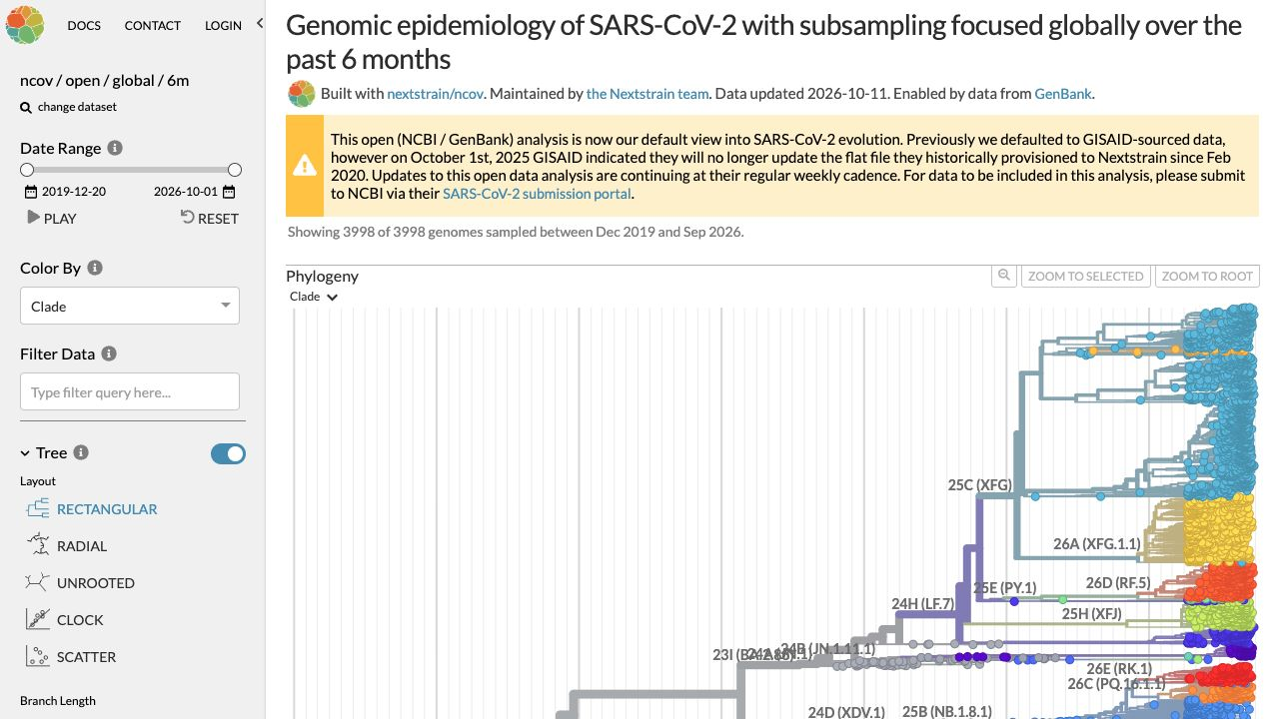
Tools and the questions they answer
Tool / system | Role
Pango / Pangolin | Lineage names / lineage assignment
Nextclade | QC and clade outputs
Nextstrain | Trees and metadata
Python / R | Reference calculations
Inspect AI | Agent evaluation and logs
Nextstrain public view
A tree still needs sampling context.
Image: nextstrain.org
10

Slide 11
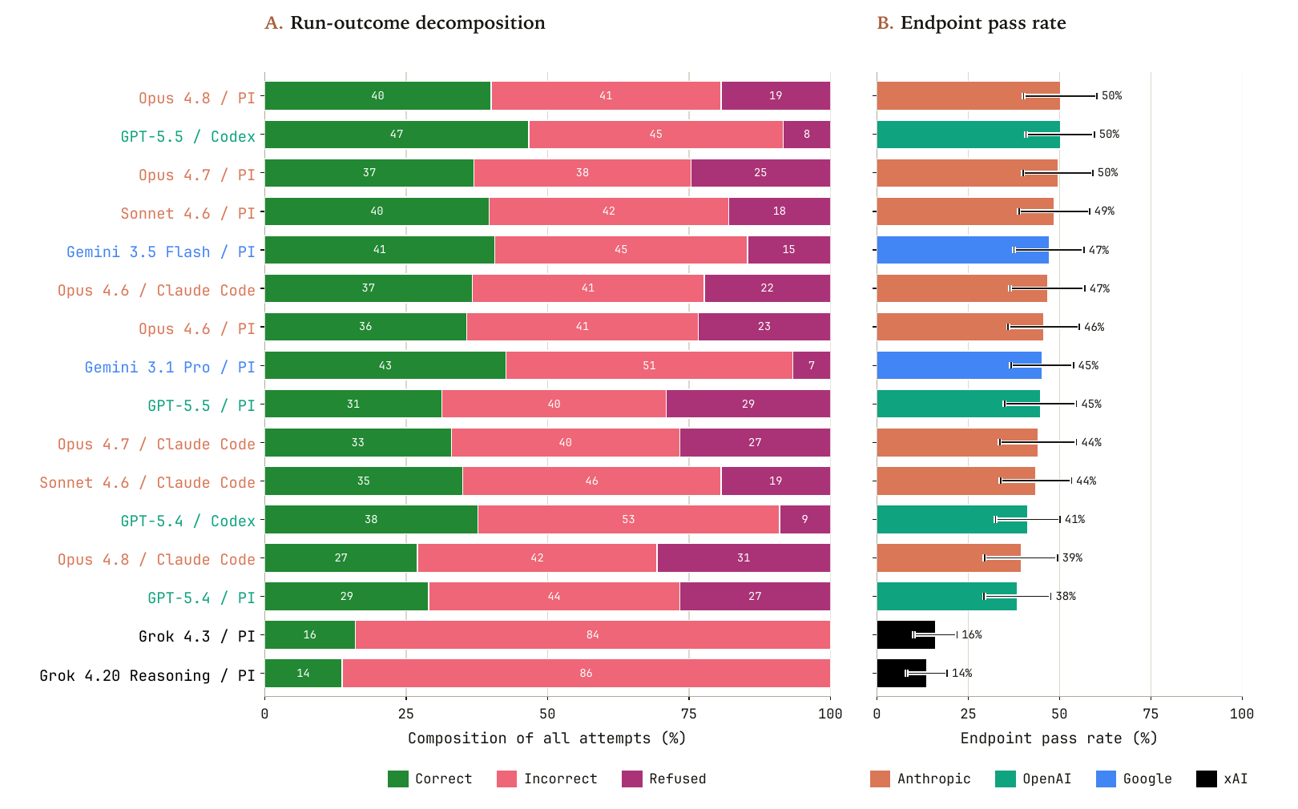
BioSecBench-Surveillance: published results
A: all attempts. B: mean pass rate among gradable attempts, excluding refusals.
Bhasin et al., arXiv 2026 (preprint), Figure 2. CC BY 4.0.
11

Slide 12
Evidence for a credible evaluation
01
A checkable reference
Expected fields, calculation, and source evidence
02
Separate scoring rules
Deterministic checks plus a review of interpretation
03
Controls for shortcuts
Neutral filenames and reordered records
04
An auditable run record
Baseline, allowed tools, versions, errors, and all attempts
12

Slide 13
A manageable first month
Proposed checkpoint | Artifact for discussion
19 October | Reading notes, candidate questions and constraints
26 October | Joint two-page scope note and one task sketch
2 November | One worked example with a reference answer and rubric
16 November | A small example set and a draft failure taxonomy
Agree the pace together. Each checkpoint produces something reviewable.
13

Slide 14
Working agreement and decisions
Question and scope
One primary setting and a clear comparison
Ownership
A lead for each artifact, with cross-review
Support
Learning goals, feedback preferences and constraints
Cadence
Weekly meeting, brief progress note and decision log
Next checkpoint
A feasible date and an artifact each person can explain
14

Slide 15
Reading and resources
Pathogen Genomics in Public Health
Armstrong et al., NEJM 2019. Includes Duncan MacCannell.
Nebraska Omicron cluster investigation
Jansen, Tegomoh et al., MMWR 2021.
BioSecBench-Surveillance
Bhasin et al., arXiv 2026. Preprint.
WHO genomic surveillance strategy
Image licences: CC BY 4.0
15

